Slide 1
Movie Sentiment Analysis Using Python
Done by:
Stephen Raj.R
Bhuvaneshwari.G
Sujatha.A
Kavithra.K
Guide:MsV.Dhanalakshmi.
(HOD CSE)

Slide 2
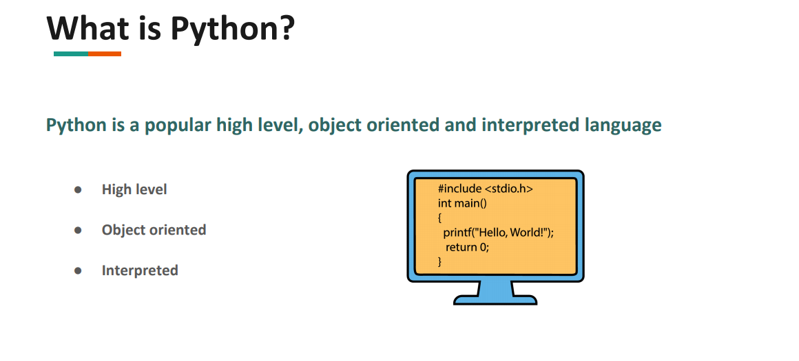
INTRODUCTION

Slide 3
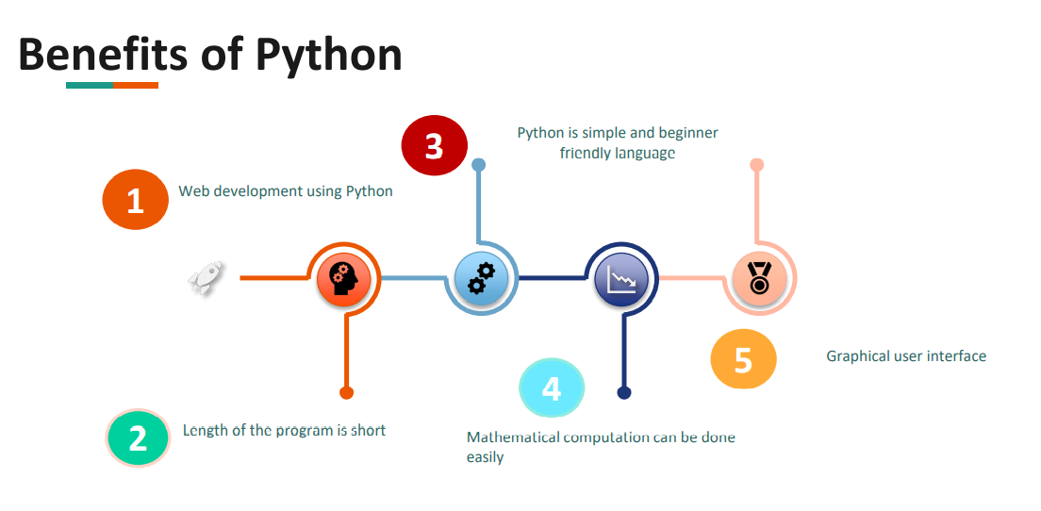
INTRODUCTION

Slide 4
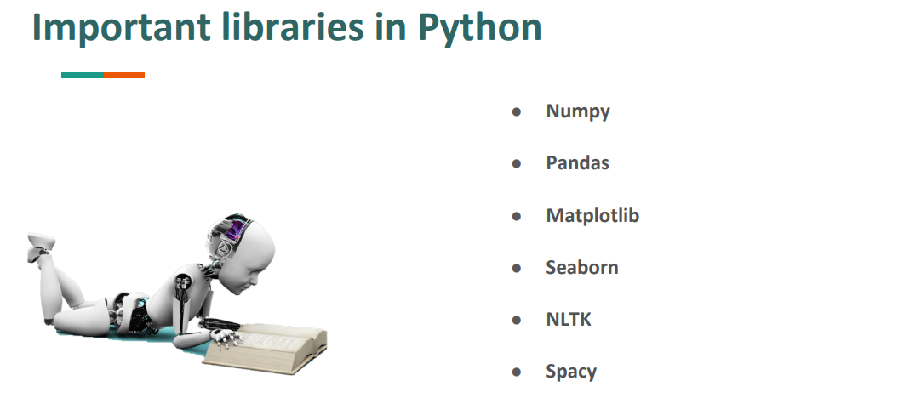
INTRODUCTION

Slide 5

ABSTRACT
NLP stands for natural language processing which is basically used to understand and interpret human language to the machine. In short it is the automatic way to manipulate the natural language, like speech and text, by software for further analysis to get the required information from them

Slide 6

PROPOSED-METHODOLOGY
The proposed methodology is implemented as:
Modeling Techniques
Ratio Of Analysis
Training AND Testing
Data
Pre-Processing

Slide 7
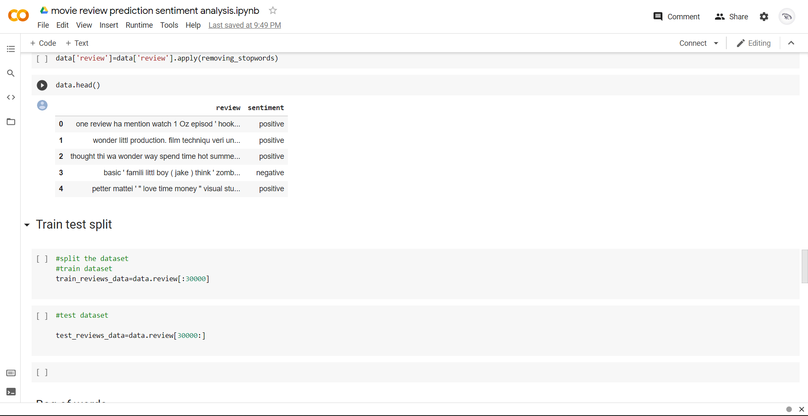
Screenshot Of the Movie Sentiment Analysis

Slide 8
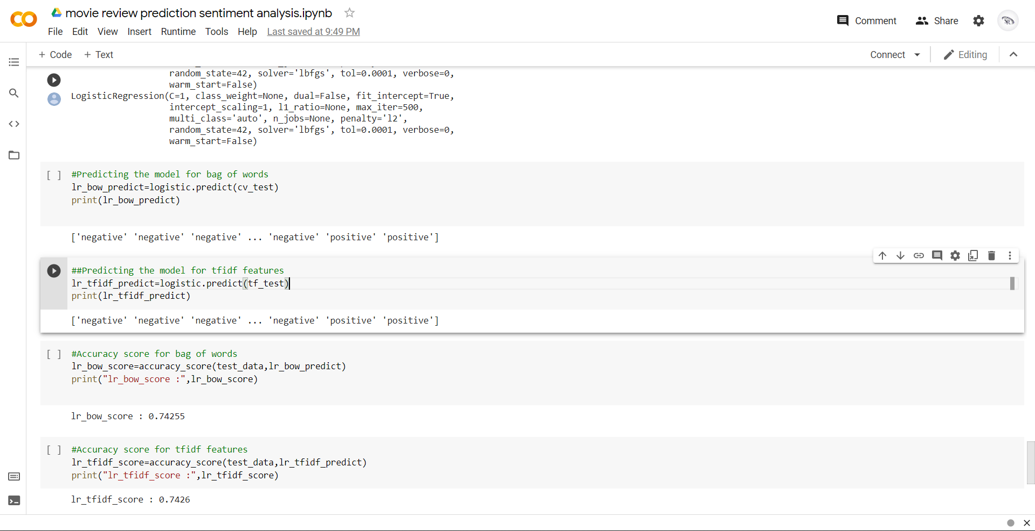
Screenshot Of the Movie Sentiment Analysis

Slide 9
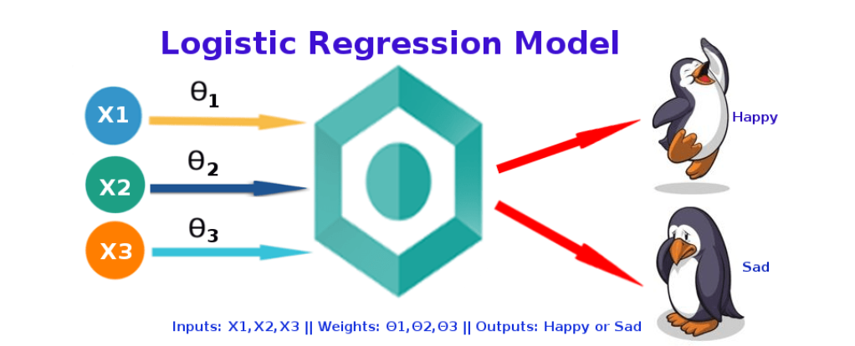
Logistic Regression

Slide 10
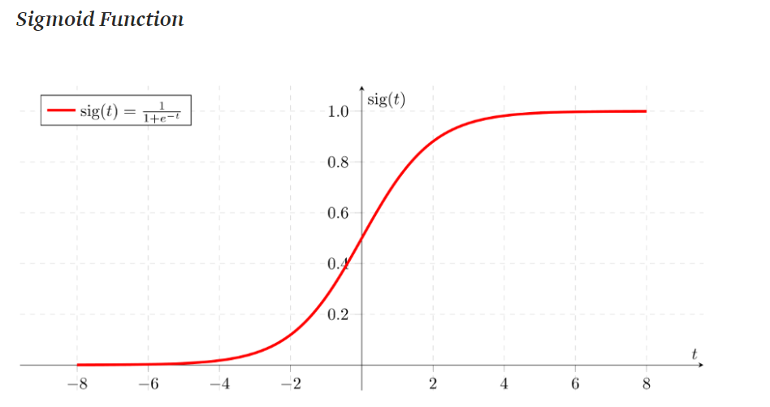
Logistic Regression
Output = 0 or 1
Hypothesis => Z = WX + B
hΘ(x) = sigmoid (Z)

Slide 11
CONCLUSIONS
We have implemented a project on Movie Sentiment Analysis, Many people of world try to get the most complicate stage of review in this project.
We tried most in the trained and tested datasets to deliver an accurate output in the positive ratio of 0.7
We must have a stable internet connection
We can not work with Complicated Words/Sentences
It is time consuming process on training and testing datasets

Slide 12
REFERENCES
I Have get my resources and datasets from the below links:
https://www.kaggle.com/ashirwadsangwan/imdb-dataset
https://www.kaggle.com/stefanoleone992/imdb-extensive-dataset
https://www.kaggle.com/lakshmi25npathi/sentiment-analysis-of-imdb-movie-reviews

Slide 13
!THANKING YOU!

